Slide 1
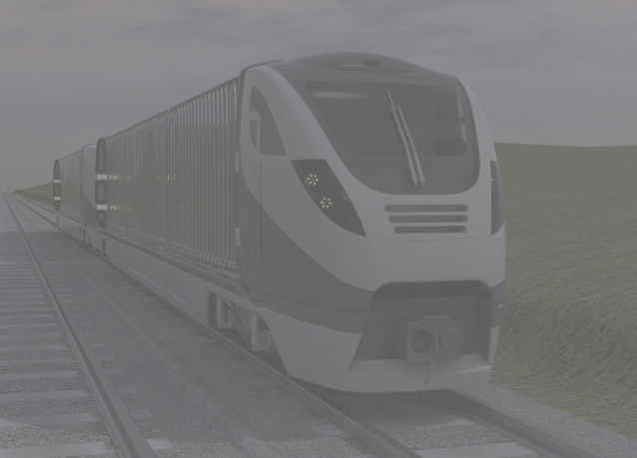
THE TRUCKTRAIN PROJECT
REAL INNOVATION IN FREIGHT
Spring 2013
Prepared by TruckTrain Knowhow Ltd,
the Coventry University Enterprises and Trucktrain Developments Ltd Company
TruckTrain

Slide 2
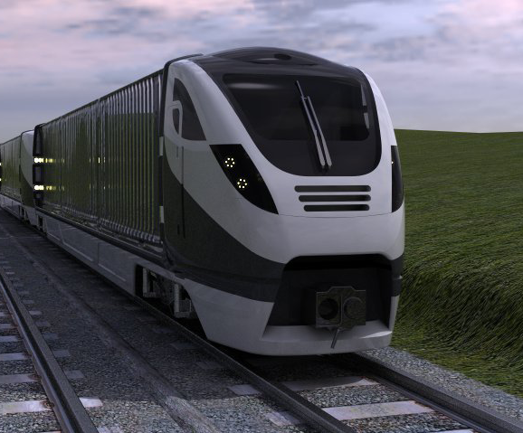
THE TRUCKTRAIN FAMILY
TruckTrain

Slide 3
DIRECT-LOAD FMU
FACTORY-WAREHOUSE SHUTTLE
TruckTrain

Slide 4
TRUCKTRAIN TECHNICAL PROFILE
Freight Multiple Unit: 2-10 cars; 4-20 TEU/
20 ft, 30 ft, 40ft, 45’ boxes & tanks
W6A, W8, or W10/12 compatible
Diesel-electric and/or 25KV/750V
All axles powered & braked
Continuous Monitoring of cargo location/integrity/condition
160 Kph with passenger train dynamics
Terminal length 46-250 metres, no run-round
Operate over 95% of Network Rail lines
Continuous Monitoring of Cargo, Train and Crew

Slide 5
LOGISTICS ENGINEERING
Trucktrain provides the opportunity for radical Railfreight performance improvement:
  Journey Times and Reliability
  Service Frequency to Customers’ premises
  Round-the-Clock operation
  Uninterruptible, continuous Monitoring
  Real Fuel and Emissions benefits
  Significant Transit Cost Improvement
TruckTrain

Slide 6
JOURNEY TIME ADVANTAGES
Short road trip length allows both shorter delivery times
and less environmental pressure
Saving:
Inventory
& Restocking
Time
Short-train
with Many
Small
Terminals
+10%
No Train
Merge
Time
No Road
Trip
Time
Train
Journey
Time
Train
Disperse
Time
Road
Trip
Time
Point-of-use
Inventory
& Delay Time
Schedule
Interval
Long-train
with Few
Large
Terminals
JUST-IN-TIME TRANSIT TIMES
TruckTrain

Slide 7
READINESS OF THE LOGISTICS
Theoretical and practical studies are always in progress:
  Urban access by Rail
  Supplier collection by Rail
  Lean, Fast-turnround Terminal
  Intermodal Monitoring Systems Trial
  Central/Regional Distribution
  Intermodal Handling investigations
  Fuel and Emissions studies
SUCCESSFUL CUSTOMER ENGINEERING STUDIES
HAVE DEMONSTRATED REAL LOGISTICAL AND COST BENEFITS

Slide 8
Project Status
PRODUCT TECHNICAL STATUS
All major units/systems engineered
Performance models demonstrate capability
Vehicle dynamics modelling shows stability
Gauge conformance 95% of NR routes
Proof of (upcoming) market studies proposed
Proof of Concept project proposed
20 man-years of engineering effort so far

Slide 9
NEXT STEP: MARKET STUDIES
Individual Sectoral Studies:
  Conurbation Delivery and Collection
  Mail and Pallets
  Small ports
  Automotive
  Provincial Centres
  Retail inter-centre Movements

Slide 10
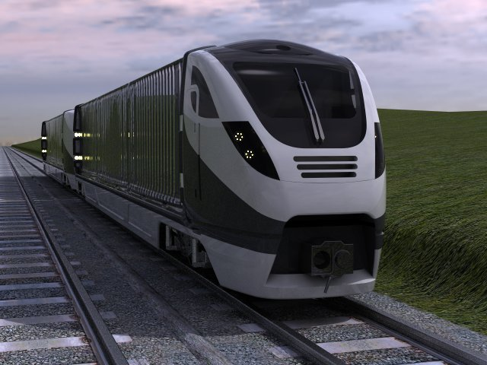
TRUCKTRAIN UNIQUE SELLING PROPOSITION
Trucktrain Knowhow will enable builders and operators to enter the fastest-growing freight market competitively:
  end-user driven business
  direct, user-to-user transits
  controlled transit environment
  passenger journey times
  passenger-quality time accuracy
  uninterruptible traceability
  use short, simple stations & loops
  lean terminals and transits
  excellent productivity of cargo, vehicles, fuel, track and staff
  low environmental profile
TruckTrain

Slide 11
TruckTrain

